Slide 1

Automated label extraction from radiology reports of chest x-rays: application of a natural language processing algorithm
Amani Johnson-Singh-Barnett
Jeffrey Petrella
Sakura Anning Yoshihara
Notes:
I’m JP speaking on behalf of Team 2 with ASB and SY. In our project we use NLP to automatically extract labels from radiology reports of CXR’s.

Slide 2
Objectives
Background
Purpose & Objective
Gather Data
Model Selection & Analysis
Evaluation of Results
Conclusion
Citations
Notes:
The organization of this presentation follows the CRISP-DM steps outlined here – that we’re all familiar with.

Slide 3
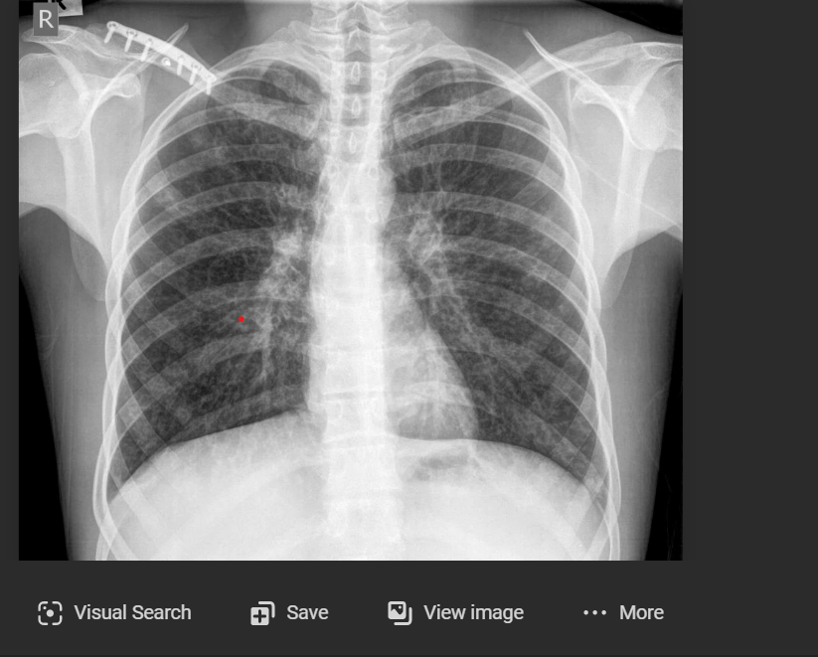

Chest X-Ray
Background
Notes:
CXR’s are one of most common imaging procedures in medicine, accounting for 40% of all diagnostic imaging.
Chest X-rays produce images of our heart, lungs, blood vessels, airways, and the bones of our chest and spine. These images help doctors determine whether a patient has heart problems, a collapsed lung, pneumonia, emphysema, cancer, broken ribs, or any of several other conditions. Because it’s easy to obtain and readily available, a CXR is often among the first procedures that a patient undergoes when a doctor suspects any disease related to heart or lung.

Slide 4
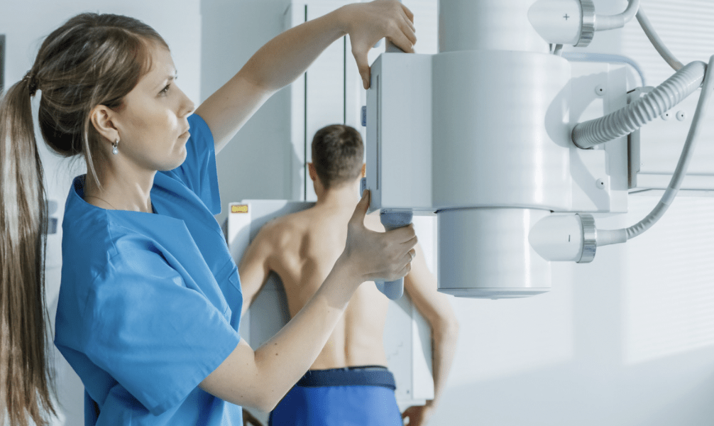
Background
Notes:
CXR are normally obtained by a certified technologist and the images sent for interpretation
https://www.xrayacademy.com/

Slide 5
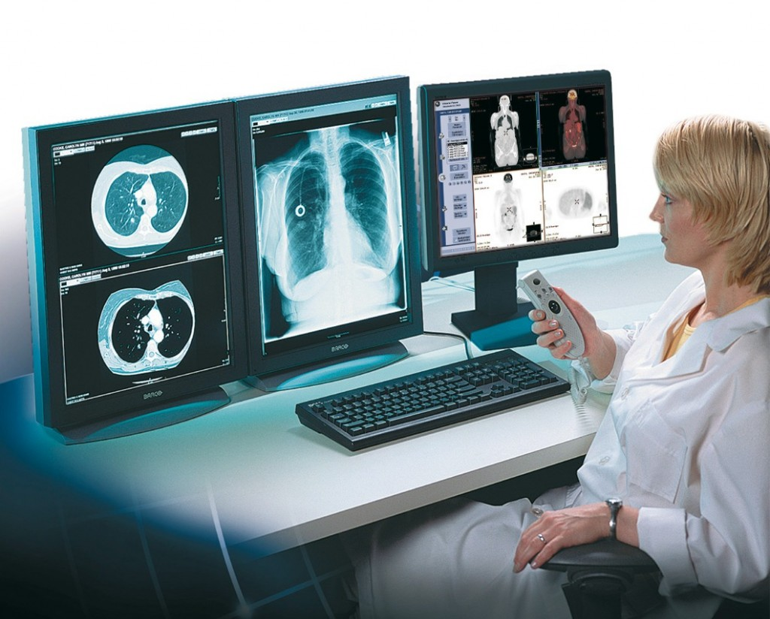
Background
Notes:
by a diagnostic radiologist, a physician with specialized training in medical imaging, who then dictates a report of the findings on the x-ray and their meaning,

Slide 6
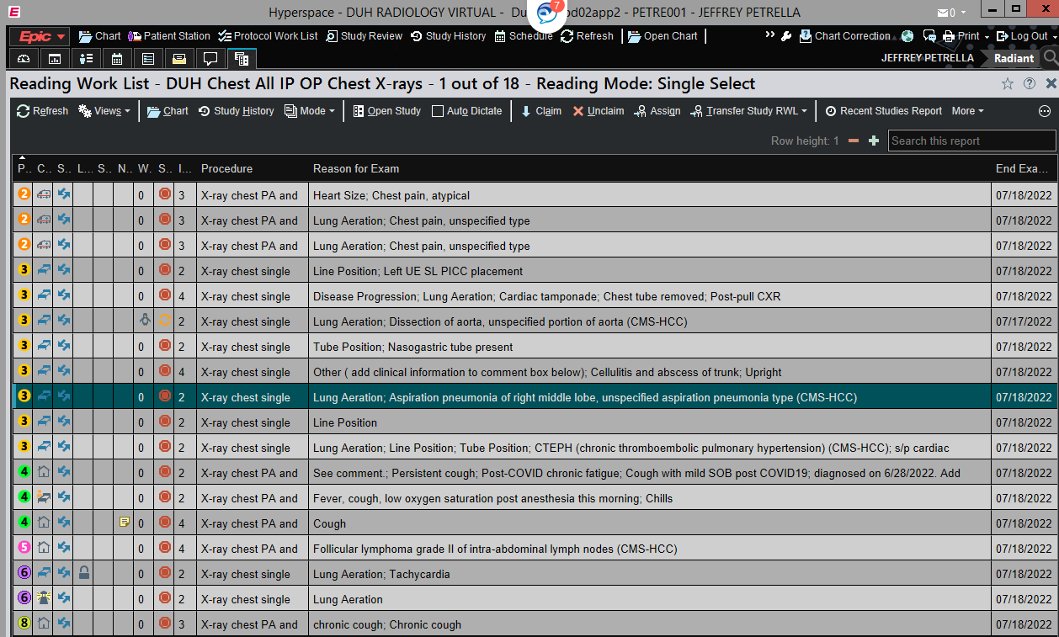
Background
Notes:
Nowadays, radiologists read from large queue’s which are prioritized by location/clinical status of the patient, e.g. Immediate, ED/Acute, ICU, Inpatient, Outpatient urgent, Outpatient today, Inpatient, Outpatient routine etc. however, often unexpected findings come up in low priority cases. Often there is a backlog of exams which further increases time to interpretation, in some cases from days to weeks.

Slide 7
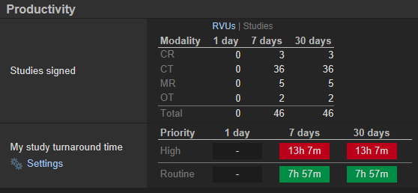
Background
Notes:
To this end, turn-around-time (TAT) is currently used by hospital systems and oversite organizations a quality-of-care metric.
To minimize the time it takes for emergent findings to be communicated, it would be great to have a tool …

Slide 8
Background
Notes:
that could triage the abnormal cases to the head of the queue to be read first by a radiologist.
The mix of normal to abnormal cases obviously varies; however, some studies have estimated that over 60% of CXR’s are interpreted as normal. If the abnormal studies could be prioritized over the normal studies, this could reduce the time for communication of potentially urgent or emergent findings in half. “Currently there are no systematic and automated ways to triage chest X-rays and bring those with critical and urgent findings to the top of the reporting pile”

Slide 9
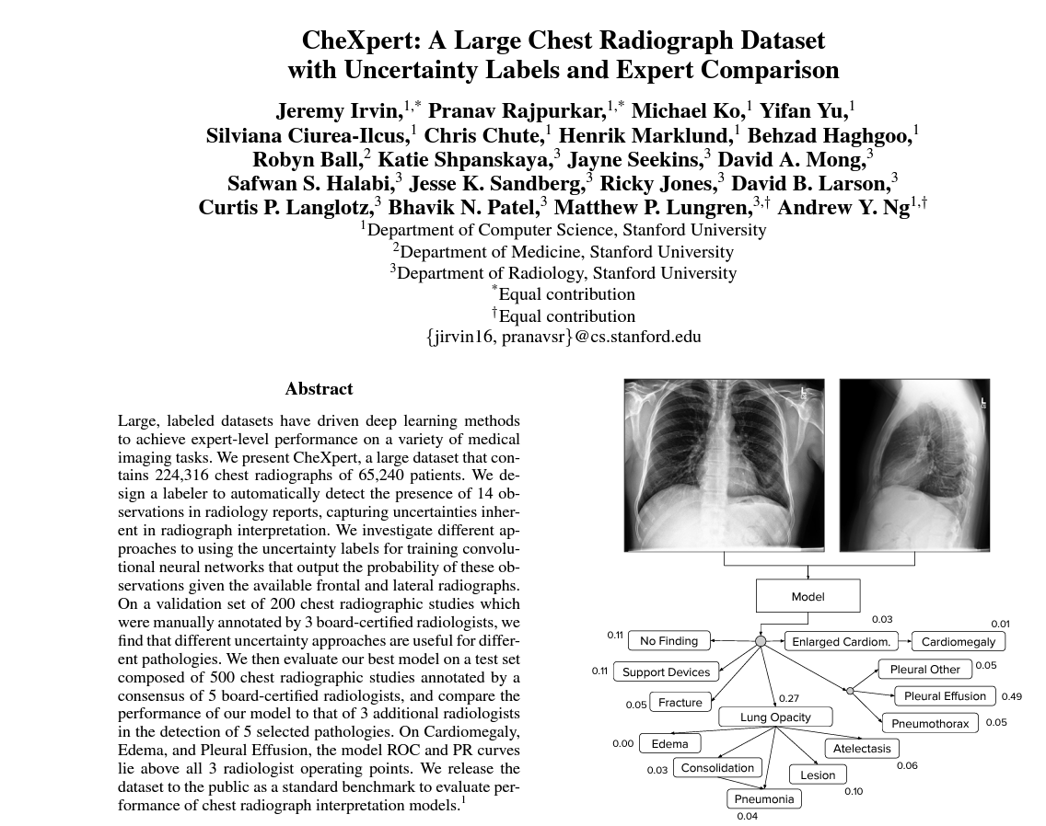
224,316 Chest X-rays
65,240 patients
14 observations in radiology reports capturing uncertainty
Background
Notes:
Multiple efforts to use AI and computer vision to help triage CXR’s are underway; however, these efforts are limited by the availability of publically-accessible sets of expertly labelled data. Though that is changing though efforts such as CheXpert, a project at Stanford to label over 200,000 radiographs.

Slide 10
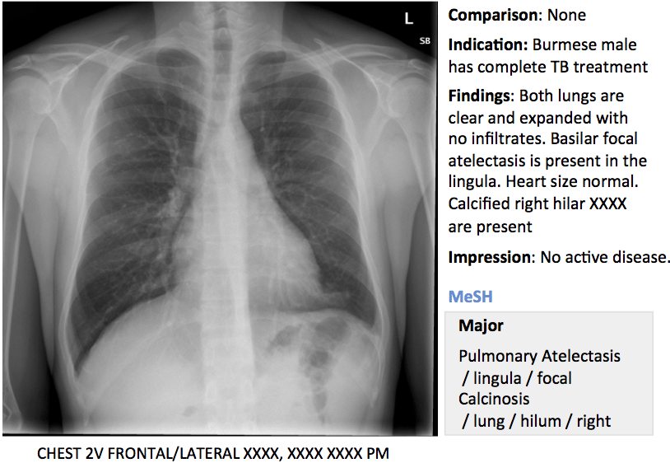
Background
Notes:
There are however an abundance of CXR images with accompanying radiology reports available in over 6000 hospital systems throughout the U.S., numbering over 100 million exams per year.
If there were a reliable way to generate weak labels in an automated fashion from CXR reports; this would have a large impact on efforts to develop computer vision systems to triage CXR for radiologic interpretation.

Slide 11
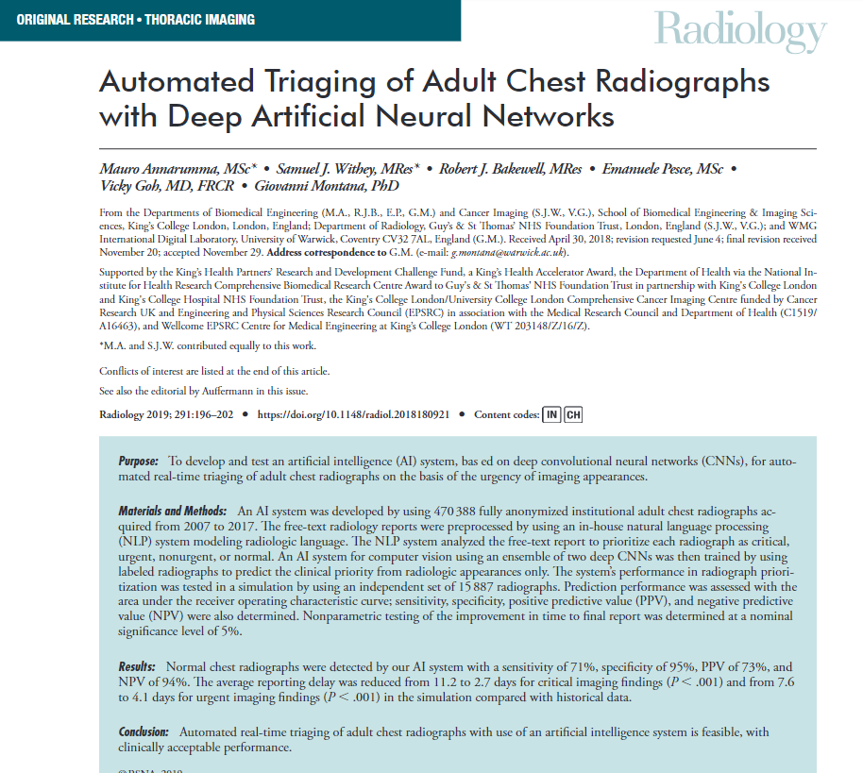
Normal chest radiographs were detected with a
sensitivity of 71%
specificity of 95%
PPV of 73%
NPV of 94%
Average reporting delay reduced from 11.2 to 2.7 days for critical imaging findings (P < .001)
7.6 to 4.1 days for urgent imaging findings (P < .001) in the simulation compared with historical data.
Background
Notes:
Such systems, already being prototyped, have been shown to reduce reporting delay of critical imaging findings by 75% and urgent findings by 50%.
Such systems could be trained by large datasets as well as tailored to a particular hospital’s case spectrum and equipment; thereby increasing their value in a local setting.

Slide 12

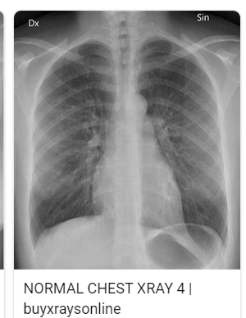
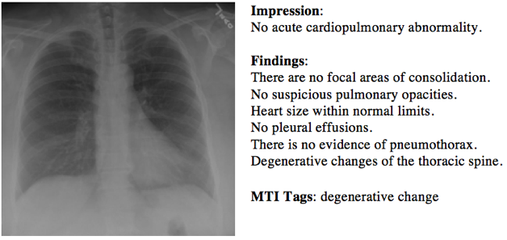
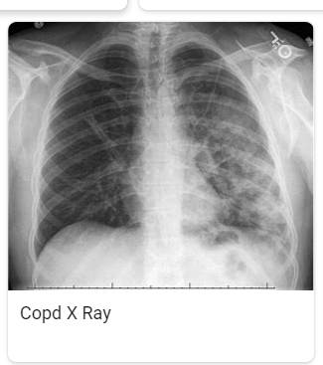
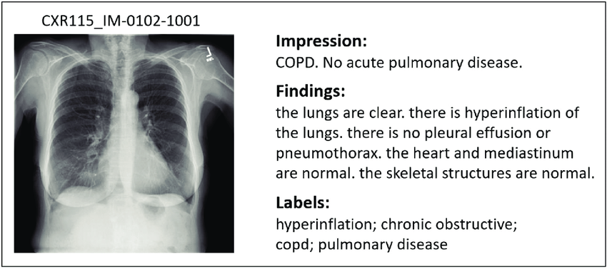
Purpose & Objective
INSTITUTIONAL DATASET
NORMAL
LOCAL TRIAGE ALGORITHM
normal chest x-ray
ABNORMAL
copd x-ray
Notes:
It was our goal to create an NLP algorithm that would take a radiology report, and create automated “weak” labels, normal vs. abnormal, with the goal of triaging abnormal cases for sooner viewing by a radiologist.
Such a tool could be used to label institutional datasets to test and tailor ML triage algorithms prior to deployment in a local hospital setting.

Slide 13

Chest X-ray datasets
NIH Chest x-ray dataset – National Institutes of Health
CheXpert – Stanford University
Chest X-Ray Images (Pneumonia) – Kaggle
VinDr-CXR – Vietnam
MIMIC-CXR - Harvard
Gather Data
Notes:
In searching for datasets to carry out this project I consulted two colleagues in Radiology and IT at Stanford University.
Although there were several publically sets of expert-labelled image data available, there were no set of labelled radiology reports.
Radiology reports turn out to be much more challenging to de-identify for public release than images and the data sets need to undergo human review before release which is more time consuming.

Slide 14
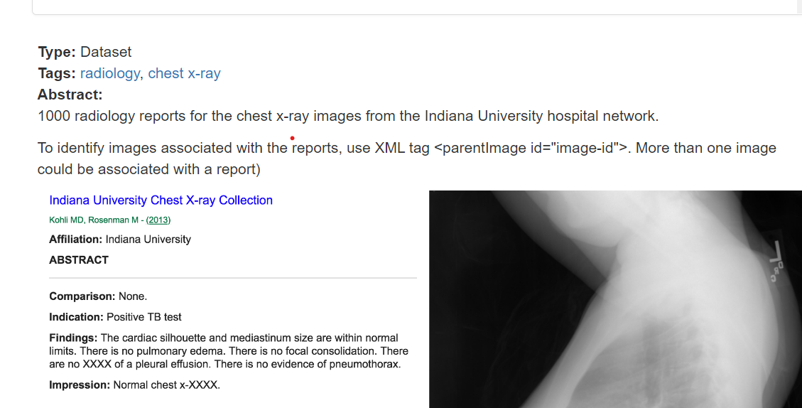
Indiana University Chest X-Rays (XML Reports)
Gather Data
Notes:
Accordingly, we were referred to this CXR dataset at Indiana University with both images and unlabeled reports available in about 421 subjects. Each report contains four sections: comparison, indication, findings and impression. We then extracted the impressions from the reports, which contain all the key imaging findings. We then used our team’s domain knowledge in medicine in general and radiology, more specifically, manually label the impressions into normal or abnormal.

Slide 15
Methods
Preprocessing:
Tokenization
Removing stop words and punctuation
Lemmatization
Create N-grams = 3
Featurized text: Bag of Words, TF-IDF
Input text and labels - normal(0) or abnormal(1)
Logistic regression
Performance Metrics: Accuracy, Recall
Data set
~400 manually labeled text impressions(80/20 split)
Gather Data
Notes:
Preprocessing data: tokenization, removing stop words and punctuation, lemmatization
Featurizing Text: create N-grams = 3 (take into account phrases such as “no cardiopulmonary pathology” a common impression in negative CXR
Featurized text using two methods for comparison: >Bag of Words>TF-IDF
Input featurize text and labels into models> normal(0) or abnormal(1)
Split data: we divided our data into test and training sets using an 80/20 split.
Modeling: initially chose a standard logistic regression model on the featurized text as baseline.
Performance metrics: accuracy and recall. Recall is particularly important in this use case from a clinical standpoint in that we would want the algorithm to reduce false negatives as much as possible so critical or urgent imaging findings would not be potentially mislabeled by computer vision systems and put to the bottom of the queue.

Slide 16

Count vectorization
 | accuracy | recall
Training set | 0.988 | 0.974
Test set | 0.916 | 0.917
tfidf
 | accuracy | recall
Training set | 0.961 | 0.915
Test set | 0.916 | 0.875
Model Selection & Analysis
Notes:
For the Bag of Words (count vectorization)
Training
Accuracy: 0.99
Recall: 0.97
Test
Accuracy: 0.92
Recall: 0.92
For the TF-IDF featurization
Training
Accuracy: 0.96
Recall: 0.92
Test
Accuracy: 0.92
Recall: 0.88

Slide 17
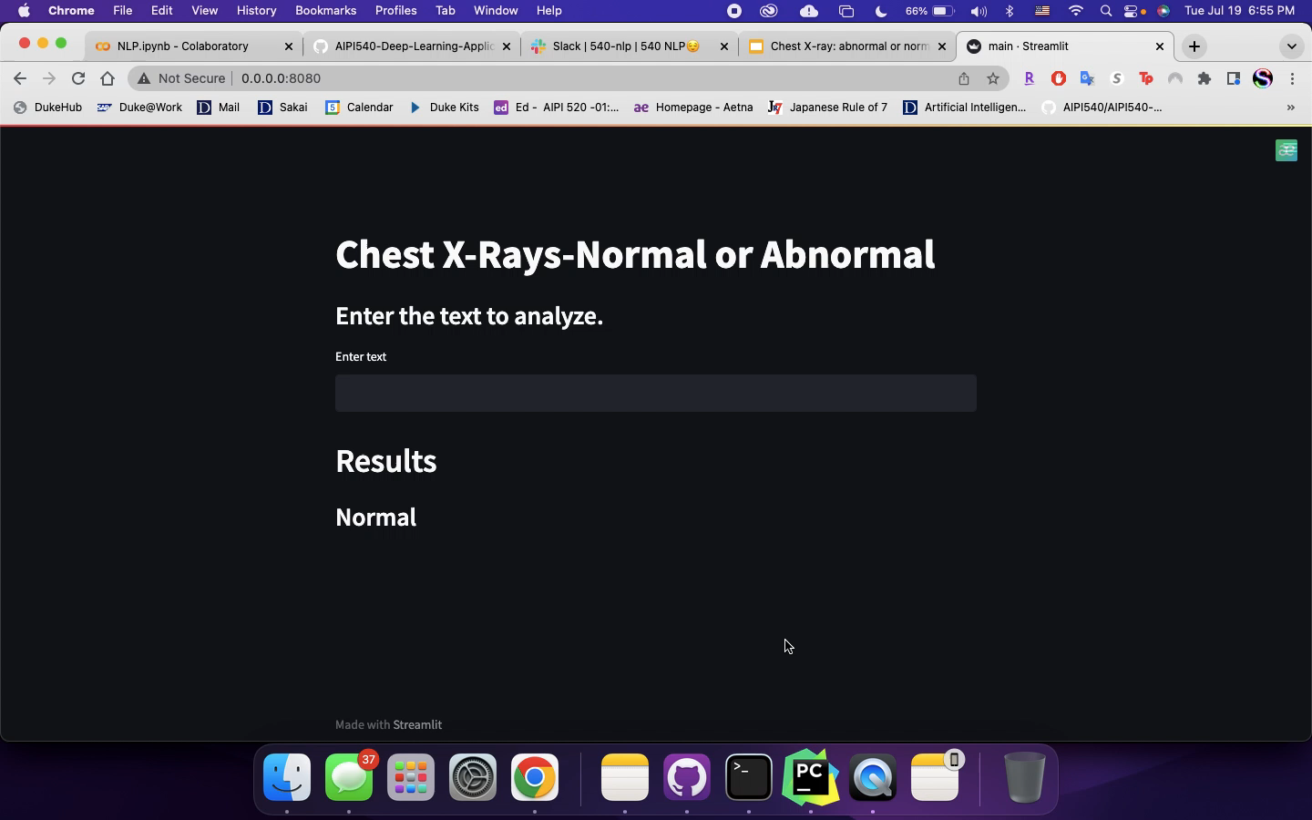

demo
Evaluation of Results
Notes:
Now show demo using the trained model (BOW) with report impressions from the test set input in model, and how the model generates output.

Slide 18

CONCLUSION
NLP to automate labeling of CXR reports
Test set: accuracy & recall (0.92)
Further work needs to be done to avoid 1/10 abnormal CXR from being mislabeled as normal
Aid training of future computer vision systems
Notes:
We created an NLP to automate the labelling of CXR reports into normal/abnormal categories.
Performance on the test set was excellent with high accuracy and recall (0.92) using basic vectorization algorithms and a standard logistic regression model.
Because recall is particularly important for this use case wrt reducing false negatives, further work needs to be done to avoid 1/10 abnormal CXR from being mislabeled as normal. Test set was small with high prevalence of negative CXR’s, perhaps by increasing training sample particularly with pos cases, using word embeddings, or more sophisticated models.
If further refined, such a tool could aid in the training of computer vision systems by markedly increasing the number of labelled samples available and, through tailoring, increase the value of these algorithms in a local setting

Slide 19

citations
Indiana University — Chest X-Rays Automated Report Generation | by Rohan kumar soni | Medium
https://www.rsna.org/news/2019/january/ai-for-chest-x-rays (Annarumma M, Automated Triaging of Adult Chest Radiographs with Deep Artificial Neural Networks, Radiology 2019)
Building Web Applications with Streamlit for NLP Projects | by Ram Vegiraju | Towards Data Science (medium.com)
Mettler FA, Radiology 2009, Radiologic and Nuclear Medicine Studies in the United States and Worldwide: Frequency, Radiation Dose, and Comparison with Other Radiation Sources—1950–2007
Irvin J, Proceedings of the 33rd AAAI conference on Artificial Intelligence, the 31st Innovative Applications of Artificial Intelligence Conference and the 9th AAAI Symposium on Educational Advances in Artificial Intelligence 2022, CheXpert: a large chest radiograph dataset with uncertainty labels and expert comparison

